Slide 1
Chapter 14 – Goodness of Fit Tests and Categorical Data Analysis

Slide 2
Outline
Goodness of Fit Tests When Category Probabilities are Completely Specified
Goodness of Fit for Composite Hypothesis
Two-Way Contingency Tables

Slide 3

14.1 Goodness of Fit Tests When Category Probabilities are Completely Specified
Null hypothesis : $H_{0}$:$p_{1}=p_{10}$, $p_{2}=p_{20},⋯,p_{k}=p_{k0}$
Alternative hypothesis : $H_{a}$: at least one $p_{i}$ does not equal $p_{i0}$
Test statistic value :
$χ^{2}=\sum_{all cells}{\frac{{\left(observed−expected\right)}^{2}}{expected}}=\sum_{i=1}^{k}{\frac{{\left(n_{i}−np_{i0}\right)}^{2}}{np_{i0}}}$
Rejection Region : $χ^{2}≥χ_{α,k−1}^{2}$

Slide 4
Goodness of Fit Test (Fitting distributions to the data)
http://www.cimt.org.uk/projects/mepres/alevel/fstats_ch5.pdf
Binomial distribution
Poisson distribution
Exponential distribution
Normal distribution : p.107

Slide 5

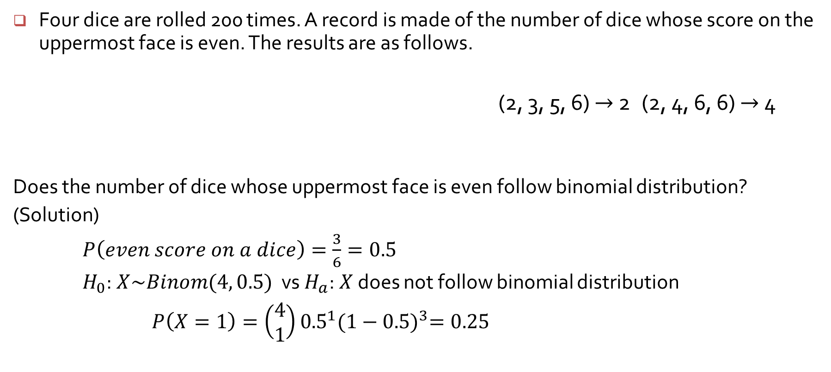
Binomial Distribution
Four dice are rolled 200 times. A record is made of the number of dice whose score on the uppermost face is even. The results are as follows.
(2, 3, 5, 6) $→$ 2 (2, 4, 6, 6) $→$ 4
Does the number of dice whose uppermost face is even follow binomial distribution?
(Solution)
$P\left(even score on a dice\right)=\frac{3}{6}=0.5$
$H_{0}$:$X\sim Binom(4, 0.5)$ vs $H_{a}$:$X$ does not follow binomial distribution
$P\left(X=1\right)=\left(\begin{matrix}4 \\ 1\end{matrix}\right){0.5}^{1}{(1−0.5)}^{3}=0.25$

Slide 6
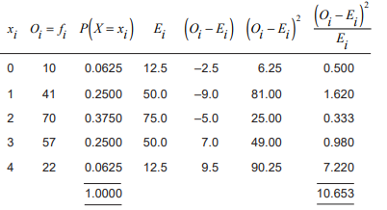
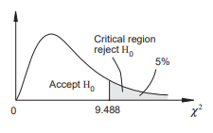
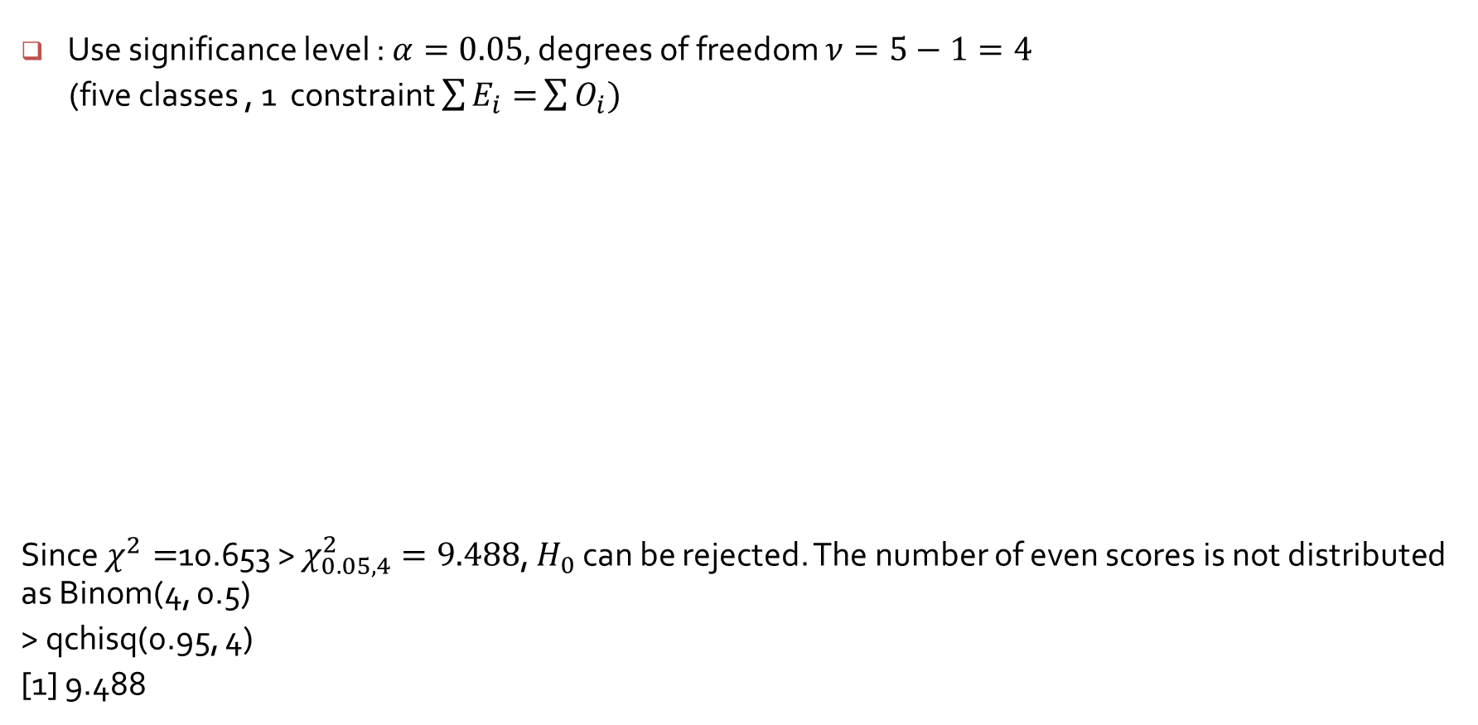
Binomial Distribution
Use significance level : $α=0.05,$degrees of freedom $ν=5−1=4$
(five classes , 1 constraint $\sum{E_{i}=}\sum{O_{i})}$
Since $χ^{2}=$10.653 > $χ_{0.05, 4}^{2}=9.488$, $H_{0}$ can be rejected. The number of even scores is not distributed as Binom(4, 0.5)
> qchisq(0.95, 4)
[1] 9.488

